Slide 1
Document Evidence
Role of Document Examiner:
1. Establish the source of a typewritten document.
2. Establish the writer and signature of questioned writings.
Questioned = unknown source or typewriter

Slide 2

Document Evidence
Everyone’s handwriting is unique because of individual characteristics:
  Developed through habits over a long time.
  Individual mannerisms of forming letters
  Becomes ingrained in muscle memory

Slide 3
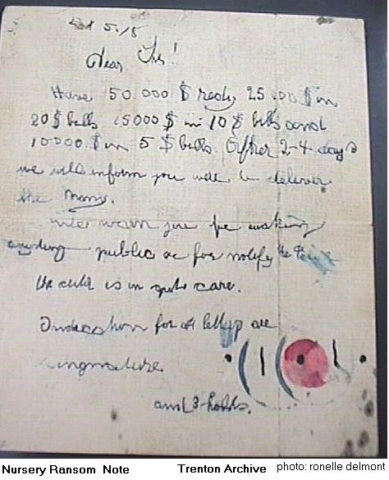
Handwriting Sample

Slide 4
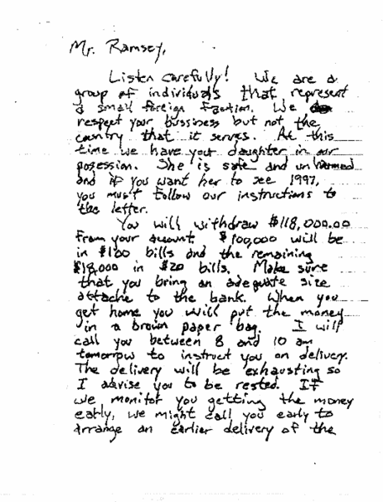
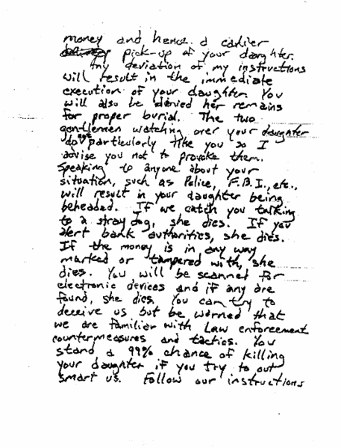

Slide 5
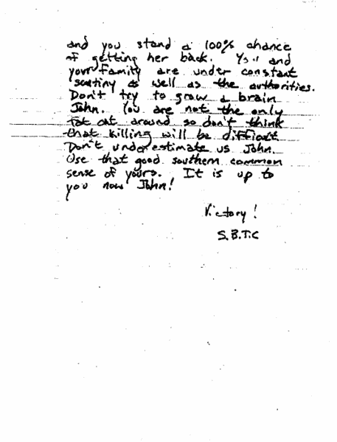

Slide 6
Document Evidence
Typewriter:
  Often asked to identify make and model of typewriter.
  Can use search warrant to seize typewriter
  Make exemplar for comparison with unknown

Slide 7
Photocopies, Printer, Fax Machines
Imperfections in the printing can help identify the make and model of the machine and in some cases the individual machine that made the copy.
  Time dependent
  New technology eliminates the old technology

Slide 8
Alterations, erasures, and obliterations
Use microscopy of altered area.
Exposure to blue/green light which creates infrared luminescence in the inks.
Infrared luminescence will cause inks to differ visibly in order to be able to determine alterations.

Slide 9
Alterations, erasures, and obliterations
Erasures are determined through microscopic examinations w/ultraviolet light (UV); infrared light (IR); high-contrast photography and examinations for indentations.
Obliterations: Microscopy, UV and IR

Slide 10
Indented Writings
Impressions made on a sheet of paper under the paper being written on.
Use oblique lighting
Electrostatic machines that preferentially attach carbon particles to the writing.

Slide 11
Ink Examinations & Comparisons
Used when more than one ink is used.
Examine inks using INK Chromatography (TLC)
Instrument known as Visible Microspectrophotometer.

Slide 12
ID Document Paper Composition and Manufacturer
Use Neutron Activation Analysis (NAA),
X-ray fluorescence and Atomic Absorption (AA) to detect chemical composition.
ID’s trace chemical elements in paper.
Different because of the use of raw materials from different sources and produced at differing time periods.

Slide 13
ID of Source of Torn Paper
In many cases torn pieces of paper can be individualized and identified through the jigsaw puzzle fashion.

Slide 14
Collection of Document Evidence
Precautions for handling questioned document evidence:
  Do not fold, cut, or tear the document
  Do not mark or write on the document
  Do not paperclip, staple, or punch holes in the document
  Do not process for latent fingerprints until after the document examnation

Slide 15
Latent Fingerprints
Process for FP last to prevent destruction of document.
Most FP are invisible and must be developed chemically
FP can last a long time on documents (deposits soak into paper)

Slide 16
Latent Fingerprints
Always use gloves or forceps when handling documents.
Place document in plastic cover for protection or paper envelopes.

Slide 17
Charred Documents
Handle charred documents as carefully as possible.
Package in cardboard box with cushioning material such as cotton or static-free bubble packing material.

Slide 18
Exemplar Writings
Known writing from the suspect.
Request Writings: From the suspect upon request. (Current Writings)
Required cooperation from the suspect.
Known writings from the past. (Bank records, letters, other writings)

